Slide 1

LGE Internal Use Only
SW Detailed Design Technique Guide
SW Process Unit
LG Electronics Inc.

Slide 2

Document Info
Document Information
Issuing authority | SW Process Unit
Status of document | In Progress / Approved / Released
Revision History
Version | Date | Comment | Author | Approver
1.0 | 2016.08.22 | Initial version | IVI SE | SW Process Team Leader
1.1 | 2018.01.16 | Updated content of PIRS-14 (VLM system) | Sookyung Yoon | SW Process Team Leader
1.2 | 2019-02-12 | Organization name change (VC→VS) | Sanghoon Lee | SW Process Team Leader
1.3 | 2019.7.1 | 3p~5p : Added multiple files cases, Context, Dynamic design, Unit design, Design alternatives, Removed Duplication 3. SW detailed design : Separated ‘Overview’ chapter Added ‘4. Context diagram’ Chapter 5 : Added ‘Design pattern’ 8p : Added multiple files cases 6. SW detailed design : Separated ‘Dynamic Design’ chapter, Added Sequence diagram example 7. SW detailed design : Separated ‘Unit Design’ chapter 8) Added ‘9. Design Alternative’ | GuanRok Park | SW Process Team Leader

Slide 3
Contents
SW Detailed Design Overview
SW Detailed Design Method
Component Overview
Context Diagram
SW Detailed Design – Static Design
SW Detailed Design – Dynamic Design
SW Detailed Design – Unit Design
Review and Improvement of SW Detailed Design
Design Alternatives

Slide 4
1. SW Detailed Design Overview
[Purpose of SW Detailed Design]
The purpose of SW detailed design is to specify the component in detail to a level that can be implemented so as to satisfy the software requirements assigned to each identified component in the software architecture.
[Design Items]
SW Detailed Design should describe the items below :
1) SW Component internal structure design (Static Design)
- When SW Component is one file : Identify interfaces, functions, variables which are elements composing the component by designing component
- When a SW Component consists of multiple files : Identify File or Class/Object.
2) Behavior according to the state of SW Component (State Design)
- Design of internal state and state transition when SW Component performs control function
3) SW Component internal interaction (Interaction Design)
- Interaction design such as call relationship between items composing SW Component
4) SW Component Internal Detailed Design
- Logic design for SW Component internal configuration items (functions)

Slide 5
2. SW Detailed Design Method
SW Detailed Design activity is performed as below:
As a basic principle, SDD, a detailed design document, should be prepared for each SWC (SW Component) defined in SAD. - SDD uses VS standard template.
SW Context Identification: Identifies the adjacent component and external interface for the design target component.
Static design: Identifies the Class/File constituting the interior of the design target component.
Define the list of interfaces, functions, and variables that are SWC internal design elements. - The defined items are specified in the Static Design item of SDD.
※ For AUTOSAR-based development: - Refer to the ‘Application SWC architecture’ designed by Vector's Davinci Developer, an AUTOSAR development tool.
Tailored and used some technical items of the template according to AUTOSAR development.
5) SW Detailed Design uses UML diagrams and performs model design referring to guidelines. - The SW model design tool uses UML tools (e.g. EA, Rhapsody). - Since it is written in C language, state control design and function call structure design are carried out in consideration of this. - The internal logic of the function is designed with a flow chart. - Write so that the development programming language and design content are maintained 100%.

Slide 6
2. SW Detailed Design Method
SW Detailed Design activity is performed as below:
6) Dynamic Design: Design the interaction between internal components (Class/Object) of Component. In this process, Class internal functions are identified. - If an object-oriented language is not used, the class is designed in response to the file.
7) Unit design (SWC Element Design): Design the parameter range and algorithm for all functions identified through this process. 8) Design alternatives: Writes design alternatives considered in the design process. (mainly for ASPICE-based projects)

Slide 7
3. Component Overview
Overall Description
The design target component is simply described based on the SW context and structure design designed in the SW architecture description (SAD).
It should be described including the functions that the component should provide, and it should be freely described using images, texts, tables, etc.
Example)
In this project, Dimming SWC implements the dimming algorithm to adjust brightness of backlight based on following information.
ALS (Ambient Light Sensor) value
Day/Night
Temperature
Offset of display brightness
And it sends the adjusting value to BLU for controlling brightness of backlight.

Slide 8
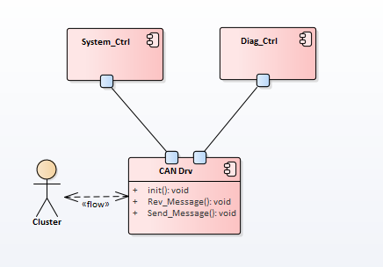
4. Context Diagram
Context Diagram
The context diagram identifies the adjacent component of the design target component and the external interface (or API) to be provided by the design target component. Since this external interface has already been defined in the higher level design, the interface list is specified by referring to SW Architecture.
Adjacent Component
Creation target component: Identifies the external interface (public) to be provided by this component.
Describe the external interface.
Parameter range and return range are mandatory.
[Context Diagram Example]
# | Port | Interface | Description | Parameters (range) | Return (range) | Error code | SRS_ID
1 |  | init | initialization | void | Void
2 |  | Rev_Message | Receives CAN message | Int (0~10) | Boolean(1:OK, 0:fail)
3 |  | Send_Message | Sends CAN message
4
[ e.g, External Interface list ]

Slide 9
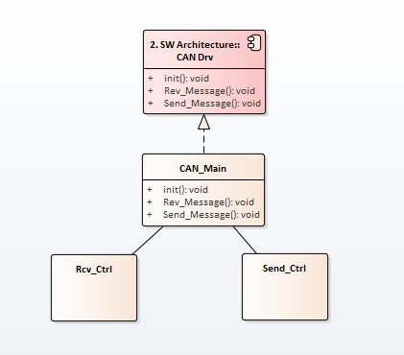
5. SW Detailed Design – Static Design
Static Design
Static Design defines the internal elements of the design target component. In general, in the case of C language-based development, a component is mapped to one file, and functions and variables defined in the file become internal elements.
When one component is mapped to multiple files, File or Class becomes an internal element. In the following case, 3 classes composing CAN drv Component are identified, and it shows that the external interface inherits the interface defined in Architecture.
Identifies Private function when doing dynamic design.
[Class Diagram Example]

Slide 10
5. SW Detailed Design – Static Design
Design Pattern
A design pattern defines an object-oriented solution that can be commonly used at the detailed design level.
By using a design pattern, it is possible to review/apply a solution at a higher level away from the details of implementation, so that the system can be built/evaluated quickly by considering the strategic aspect.
Design pattern classification
Type | Creation pattern (characteristics) |  | Structure pattern (characteristics) |  | Behavior pattern (characteristics)
Class | Factory Method | subclass of object to be instance | Adapter | interface for object | Interpreter | syntax and interpretation of language
 |  |  |  |  | Templated Method | algorithm selection procedure
Object | Abstract Factory | family of product object | Adapter | interface for object | Chan of Responsibility | object that can handle requests
 | Builder | create complex object | Bridge | object implementation | Command | when and how to process request
 | Prototype | class of object to be instance | Composite | object structure and complex of object | Iterator | access and traverse aggregate elements
 | Singleton | single instance | Decorator | adding responsibilities to objects without inheritance | Mediator | how do some objects interact with other objects?
 |  |  | Proxy | object location and access method | Memento | what private information is stored outside the object and when?
 |  |  | Flyweight | object storage cost | Observer | how to update dependent object
 |  |  | Facade | sub system’s interface | State | object state
 |  |  |  |  | Strategy | algorithm selection
 |  |  |  |  | Visitor | adding operation

Slide 11
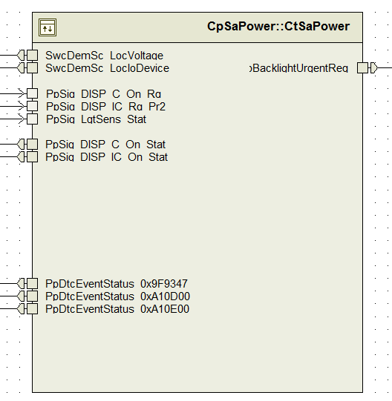
5. SW Detailed Design – Static Design
Static Design
※ For AUTOSAR-based development:
Based on the static architecture design (Application SWC design) designed in Davinci Tool, which is an AUTOSAR development tool, the component to be targeted for Detailed Design is defined.
[Design Target Component]

Slide 12
5. SW Detailed Design – Static Design
Static Design - Interface Port
※ For AUTOSAR-based development:
List the input/output interface ports of the component to be designed, and define the function (handling function) to process the data transmitted through it. Interface Port is an AUTOSAR standard interface, and the port name and port type are determined when designing the SW architecture, and it is defined as an actual interface on the RTE code according to the port name and type at the time of frame SW generation. A processing function means a function that uses an actual interface.
Interface Port | IN/OUT | Handling Function | Remark
SwcDemSc_LocVoltage | OUT | RCtSaPower_100ms
SwcDemSc_LocIoDevice | OUT | RCtSaPower_100ms
PpSig_DISP_IO_On_Stat | OUT | CtSaPower_Get_Power_Status
PpSig_DISP_C_On_Stat | OUT | CtSaPower_Get_Power_Status
PpSig_DISP_IO_Rg_Pr2 | IN | RCtSaPower_100ms
PpSig_DISP_C_On_Rg | IN | RCtSaPower_100ms
PpSig_LgtSens_Stat | IN | RCtSaPower_100ms
PpDtcEventStatus_0x9f9347 | OUT | CtSaPower_Check_Voltage_Level
PpDtcEventStatus_0xA10D00 | OUT | CtSaPower_Check_Voltage_Level
PpDtcEventStatus_0xA10E00 | OUT | CtSaPower_Check_Voltage_Level
BacklightUrgentReq | OUT | RCtSaPower_100ms
[Design Target Component]
[Interface Port]

Slide 13
5. SW Detailed Design – Static Design
Static Design – Variable List
Defines variables necessary to process input/output data delivered through component interface or to process and store
data internally. In general, global variables to be used in components are defined here.
The detailed definition items are as follows.
Type: Defines the variable type. In the case of user-defined types, details should be additionally described in Description.
Name: Defines the variable name according to the naming rule.
Description: Describes the data stored in the variable, and describes the range of data values.
Remark: Describe when there are restrictions on the use of variables. (e.g. applied model variant)
Type | Name | Description | Remark
Structure | SwcBluVariable | Store status data related BLU typedef struct _swc_blu { uint8 ui8VariantType; // range: 1~5 uint16 ui16Lcd1PwmDutyCycle; // range: 0~32768 boolean bLcd1BluEnStat; // BLU_EN Pin Stat boolean bLcd1BluCanEnCtrl; // DISP_C_BackLgt_Rq & DISP_IC_Rq_Pr2 Value boolean bLcd1BluDeserialEnCtrl; // Lock Status Value boolean bLcd1BluFpgaEnCtrl; // Safety Status Value uint16 ui16Lcd2PwmDutyCycle; // range: 0~32768 … … } SwcBluVariable;
[Variable List]

Slide 14
5. SW Detailed Design – Static Design
Static Design – Function List
Defines the function that composes the design target component.
Describes the list of functions by including the functions defined as the component interface and additionally identifying the necessary internal logic processing functions to implement the requirements.
The detailed definition items are as follows.
No. : Describes the identifier of the function.
Name: Defines the function name according to the naming rule.
Classification: Defines the function type. It can be defined considering the development language and environment.
Remark: Describe when there are restrictions on the use of functions. (e.g, applied model variant )
No. | Name | Classification | Remark
SWU_01 | RCtSaPower_Init | Runnable
SWU_02 | RCtSaPower_10ms | Runnable
SWU_03 | RCtSaPower_100ms | Runnable
SWU_04 | CtSaPower_Adc_VoltageDet_Complete | Static (Internal)
SWU_05 | CtSaPower_Power_On_Sequence | Static (Internal)
SWU_06 | CtSaPower_Power_Off_Sequence | Static (Internal)
SWU_07 | CtSaPower_Display_On_Sequence | Static (Internal)
SWU_08 | CtSaPower_Display_Off_Sequence | Static (Internal)
SWU_09 | CtSaPower_Check_Voltage_Level | Static (Internal)
SWU_10 | CtSaPower_Get_Power_Status | Static (Internal)
[Function List]

Slide 15
5. SW Detailed Design – Static Design
Static Design – Function List
※ For AUTOSAR-based development:
Design tools are used for component and interface design conforming to AUTOSAR design standards. The SW component and interface designed through this are automatically generated as a function that can be operated on the AUTOSAR platform at the time of Frame SW Generation.
Only the additional internal functions necessary to implement the internal processing logic and requirements of the automatically generated function are defined by the developer.
Therefore, in the function list, it is necessary to classify and describe the types of functions by reflecting these characteristics.
Classification of function types is as follows.
Runnable
Basic unit functions operating on the AUTOSAR platform
A function that the system should call at the time of initialization or periodically
At the time of SW architecture design, the Runnable function included in the task is identified when designing the task.
The function prototype code is automatically generated, and the function name starts with an uppercase letter ‘R’.
Callback
A function to handle the Notification delivered from the platform.
Notification to be processed by SW Component is defined at the time of Frame SW Configuration
Static (internal)
Functions additionally defined and used by developers to implement internal logic
Defines functions to be called from Runnable or Callback

Slide 16
6. SW Detailed Design – Dynamic Design
Dynamic Design
Detailed Design of SW implemented in C code performs dynamic design as follows.
State Design
Design state transition according to event or condition by identifying the state of SW Component.
Design the state machine by using the UML state diagram.
State design is not performed if it does not have an internal state, such as a component that handles simple input/output that does not perform a control function or a component whose execution state is determined externally.
Interaction Design
In a structured language such as C code, the call structure between internal functions should be designed during detailed design.
Design the call structure between functions by using the UML activity diagram. It can be designed by replacing it with a sequence diagram.
Design the function call structure only for functions that call other functions inside the component.
The depth of the function call should not exceed the maximum of 5 depth, and if the depth of the function call exceeds 3 depth, the structure below 3 depth is divided and written separately for readability when creating the design model.
If the elements of component are Class/Object, design the relationship between them as a sequence diagram. In this case, internal elements and adjacent components are also included. (next example)
Include adjacent component referring context diagram.
Place the component (Class/Object) of the component on the life line (here, the object)
External interface
External interface
Internal interface (private function) identified through the dynamic c design.
[Sequence diagram example]

Slide 17
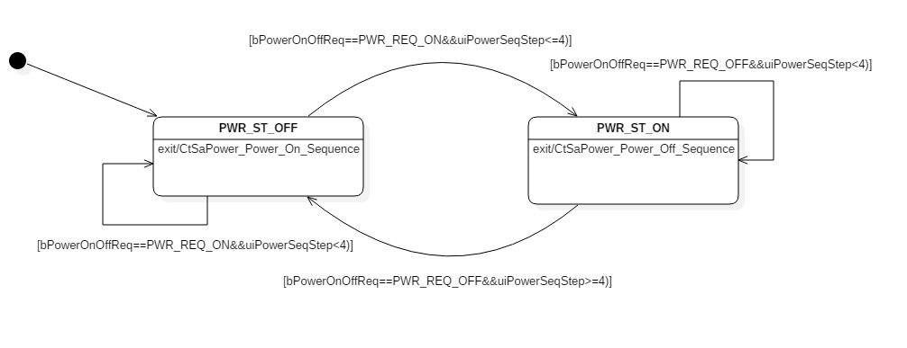
6. SW Detailed Design – Dynamic Design: State Design
State Design
When SW Component has a control function, it performs a series of tasks to control and change the control state according to an event or condition. In this case, the state transition must be clearly designed through a state machine.
Initial state
State
Transition

Slide 18
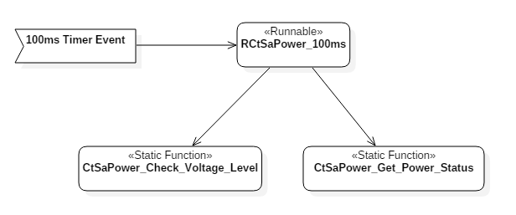
6. SW Detailed Design – Dynamic Design: Interaction Design
Interaction Design – Function call structure
The call structure inside the function is defined based on the type of function that is called by the system at the time of initialization or periodically and the type of function that is triggered from the outside. These include AUTOSAR-based development, Runnable type, and Callback type.
Note that all functions recorded in the Function List must be expressed without omission in the call structure. That is, there should be no unused functions.
1 depth
event, signal or trigger
top-level function
internal call function
2 depth
[Interaction Design]
call procedure

Slide 19
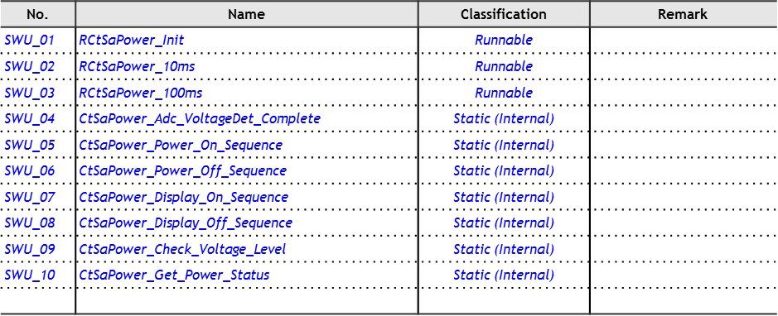
7. SW Detailed Design – Unit Design
SWC Elements Design
Design the detailed functions composing SWC. You must design for all functions described in the Function lists of Static Design. Detailed Design items are as follows.
Description: Briefly describe the function of the function in one line.
Algorithm: Describes the internal logic of a function according to the main processing procedure.
Design the logic in detail using a flow chart or pseudo code.
Logic that includes a branch in the processing procedure or the processing procedure exceeds 5 statements (Statements) must be designed with a flowchart or pseudo code.
If return is not void, return is included as the last step (including return range).
Inputs: Defines the type of input data (parameter) and the range of input values.
Outputs: Defines the type of output data (parameter, return) and the range of output values.
Target: Global data that is changed during processing, input data that is changed during processing (when input is received as a pointer), Return Value, etc.
SRS_ID: Securing traceability with SRS.
Description : Enable the power of each device block according to the device power sequence as below.(SRS_ID)
Algorithm :
1. Battery 12V Power on
2. Can Transceiver 5V Power on
3. System 3.3V Power on
4. Can Transceiver chip enable
5. Return result (1: ok, 0 : fail)
Inputs
Void
Outputs
Return Bool
[Function List]
[SWC Elements Design]

Slide 20
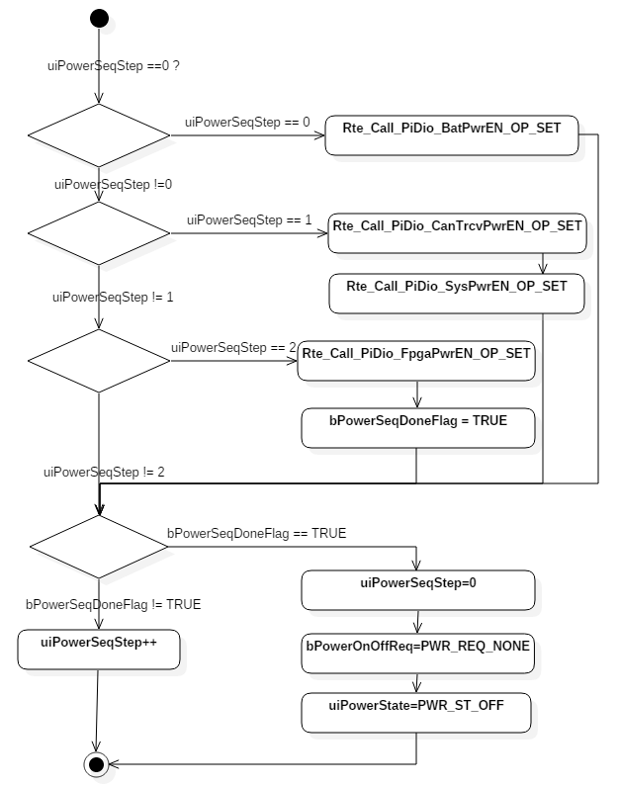
7. SW Detailed Design – Unit Design
Algorithm Design
Function internal logic (algorithm) is detailed design using pseudo code or flowchart as follows. Detailed Design level should be at a level where actual coding is possible.
[pseudo-code]
[flow chart]
Description : Enable the power of each device block according to the device power sequence as below.(SRS_ID)
Algorithm :
1. Battery 12V Power on
2. Can Transceiver 5V Power on
3. System 3.3V Power on
4. Can Transceiver chip enable
5. Return result (1: ok, 0 : fail)
Inputs
Void
Outputs
Return Bool

Slide 21
8. Review and Improvement of SW Detailed Design
The SW Detailed Design result should be written in detail to the level where SW can be implemented, and the SW source code is the result of implementing the SW Detailed Design, and in principle, it should be consistent with the Detailed Design. If the SW source code implementation differs from the design, the design change must be made at the same time.
SW Detailed Design results can be improved as a result of performing the following activities.
Verification Review
Review and evaluate the detailed design, then improve it.
Static Analysis
As a result of the static analysis of the SW source code, if the complexity of the measured function does not meet the standard, improvement must be performed to satisfy the standard through function division or function internal logic improvement.
SW Unit Test
As a result of performing unit tests on SW source code, if the coverage of the measured unit function does not meet the standard, and a change in the internal logic design of the function is necessary to satisfy the coverage criteria, improvement must be performed to meet the standard.

Slide 22
9. Design Alternatives
[For ASPICE-based Project]
Design alternatives are identified for optimal design, and design alternative selection criteria are identified and selected.
Relevant personnel participate in selection criteria and design alternative selection.
A design alternative is prepared by considering the following three cases.
Initial design: Identify the design pattern (page 9) suitable for the purpose. Identify and select the design solution for the following quality attributes.
Interoperability, interaction, criticality, technical complexity, risks and testability, etc.
Update due to iterative design: review of structural changes or alternative solutions for added functions
Identifies and selects a solution for change compared to the existing structure.
Reuse of an existing design (e.g, platform): Assess the suitability of an existing design.
If there are weaknesses, figure out how to overcome them.

Slide 23
End of Document

